Slide 1
Covid Tracker
Spencer Arnold

Slide 2
My hypothesis

Slide 3
My hypothesis
There is an overall significance of Black deaths to total cases more so than LatinX deaths to cases

Slide 4
New York, Black deaths to cases vs LatinX deaths to cases
April 12th - July 19th 2020

Slide 5
New York, Black deaths vs LatinX deaths contd.
April 12th - July 19th 2020
Total Black deaths: 4,483

Slide 6
New York, Black deaths to vs LatinX deaths contd.
April 12th - July 19th 2020
Total Black deaths: 4,483
Total LatinX deaths: 4,546

Slide 7
New York, Black deaths to vs LatinX deaths contd.
April 12th - July 19th 2020
Total Black deaths: 4,483
Total LatinX deaths: 4,546
Total Cases: 71,412

Slide 8
Understanding the Data - Two Sample Approximate Test of Population Proportions
Difference in sample proportions was 0.00

Slide 9
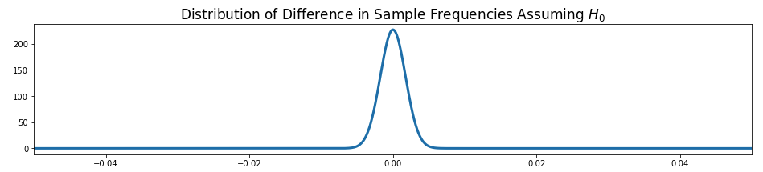
Making Sense of The Data
Difference in sample proportions was 0.00

Slide 10
Making Sense of The Data contd.
Difference in sample proportions was 0.00
My p-value for deaths frequency comparison was 0.35

Slide 11
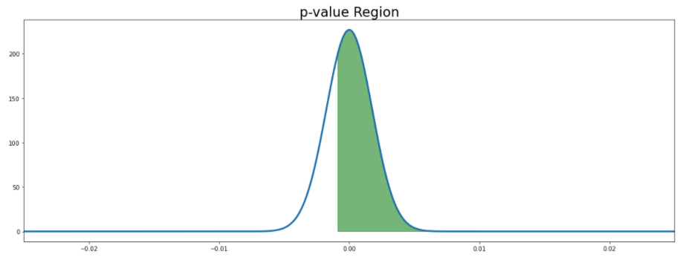
Making Sense of The Data contd.
Difference in sample proportions was 0.00
My p-value for deaths frequency comparison was 0.35

Slide 12
Making Sense of The Data contd.
Difference in sample proportions was 0.00
My p-value for deaths frequency comparison was 0.35
Failed to reject my Null hypothesis

Slide 13
Next Steps
Larger sample size is a must!
More Race data - difficulties as not every state reports this

